Slide 1
Student Orientation
Financial Services Staff

Slide 2
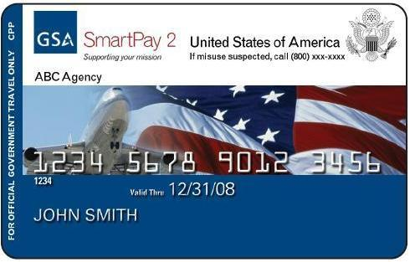
CITIBANK GOVERNMENT TRAVEL CARD PROGRAM
NEW CARDHOLDERS
Must have HRD in-processing paperwork
After you receive your email address account you will receive the forms below by submitting request email to Jordan Miles, Jordan.s.miles.civ@ndu.edu:
  Citibank Applications
  Statement of Understanding (SoU)
  Travel Card Training - Passport Trax training (Travel 101) https://www.defensetravel.dod.mil/ <https://www.defensetravel.dod.mil/
Jordan Miles – AGENCY PROGRAM COORDINATOR

Slide 3
CITIBANK GOVERNMENT TRAVEL CARD PROGRAM
TRANSFERRING CARD INFORMATION - FORMER DOD AGENCY ONLY
Must have HRD in-processing paperwork
Complete Transfer Form – Social Security Number or Account Number required
  Update address, phone number, date of birth
NEW DOD TRAVEL CARD REQUIREMENT THE GOVERNMENT TRAVEL CHARGE CARD REGULATIONS: AUTHORIZED BY DoDI 5154.31, VOLUME 4. IT REQUIRES ALL GOVERNMENT TRAVEL CARD HOLDERS TO RECEIVE TRAINING ON THE USE OF THE TRAVEL CARD, AND FOR THE AGENCY PROGRAM COORDINATOR (APC: Mr. Jordan Miles, NDU-RMD) TO MAINTAIN A FILE OF TRAINING CERTIFICATION OR TEST.
Jordan Miles – AGENCY PROGRAM COORDINATOR

Slide 4
PASSPORT/VISA
Resource Management Directorate assists with the issuance of Official Passports (Brown) & Visas
Military and Federal Government Civilians must travel with an Official Passport when travelling on Official Government Business
Begin the process for the Official Passport at www.travel.state.gov
The Passport application must be completed online
  Provide passport application to your school Certified Passport Agent
  Certified Passport Agents
    National War College – Mr. Dave Pearson 202-685-4344
    Capstone – Mr. Cliff Wheeler 202.685.4250
    RMD - Mrs. Karen Warner 202-685-4846

Slide 5
Defense Travel System (DTS)
What is DTS?
DTS is a fully integrated, electronic, end-to-end travel management system that automates temporary duty (TDY) travel for the Department of Defense. It allows travelers to create authorizations, book reservations, receive approval, generate vouchers for reimbursement, and direct payments to their bank accounts and the Government Travel Charge Card vendor, via a single web portal.
DTS provides full functionality, accessibility, and security when processing travel documents. You may search for airline, hotel, car rental, and rail availability as well as gather other details to plan a trip.
Real-time* reservations for air, lodging, and rental cars are built into DTS to provide easy access to commercial travel service information. The system streamlines workflow and processes to improve efficiency and productivity. *Exception: Southwest Airlines
DTS meets the major functional requirements of the DoD and serves the needs of all users and travelers. The following are highlights of some of DTS' major functions
Policy
  JTR
  NDU (Business Rules)
  https://portal.ndu.edu/Policies%20Instructions%20and%20Guidance/Travel%20Requests%20and%20Defense%20Travel%20System%20Instruction.pdfBrigade
Your Responsibility
  Be pro-active in learning and asking questions
  Look over the training on the website (https://www.defensetravel.dod.mil/Passport/bin/Passport.html)
  Entering orders in DTS at least 30 days prior to travel
  Making reservations for airfare and car rentals in DTS, must use CTO for all reservation
  Confirming lodging and dates (some Lodging reservation are made outside of DTS and paid CBA )
  Save Receipts for Everything for voucher reimbursement
  CAC is required to access DTS on any platforms

Slide 6
DTS Travel Authorization
*Example of DTS process to create orders and travel.
Interface with CTO
for lodging, rentals
transportation
Traveler/Admin inputs
travel order in PC
Authorizing Official approves electronically
TDY/TAD
Ticketing
Traveler receives completed order; prints as needed

Slide 7
Defense Travel System (DTS)
What is Group Travel?
To save time when two or more people travel together to the same TDY location, you can create a single document known as a group authorization, to capture travel details common to all group travelers. Later, DTS splits the group authorization into individual authorizations, allowing each traveler to enter details unique to their own trip. After travel, each traveler creates and submits a voucher to claim reimbursement for the expenses they incurred and payment for the allowances they earned.
The Faculty Lead will email or call Travel Management Company Group Desk to assist in making reservations for the entire group.
Group Authorizations have the same options of printing, adjusting, and amending (depending on the document status) as a regular authorization. Once the AO approves the group authorization, DTS separates the single group document into individual travel authorizations.
Once you return from your trip, you can file your voucher as normal.
LAKISHA WHITE – DTS ADMIN, 202-685-3955

Slide 8
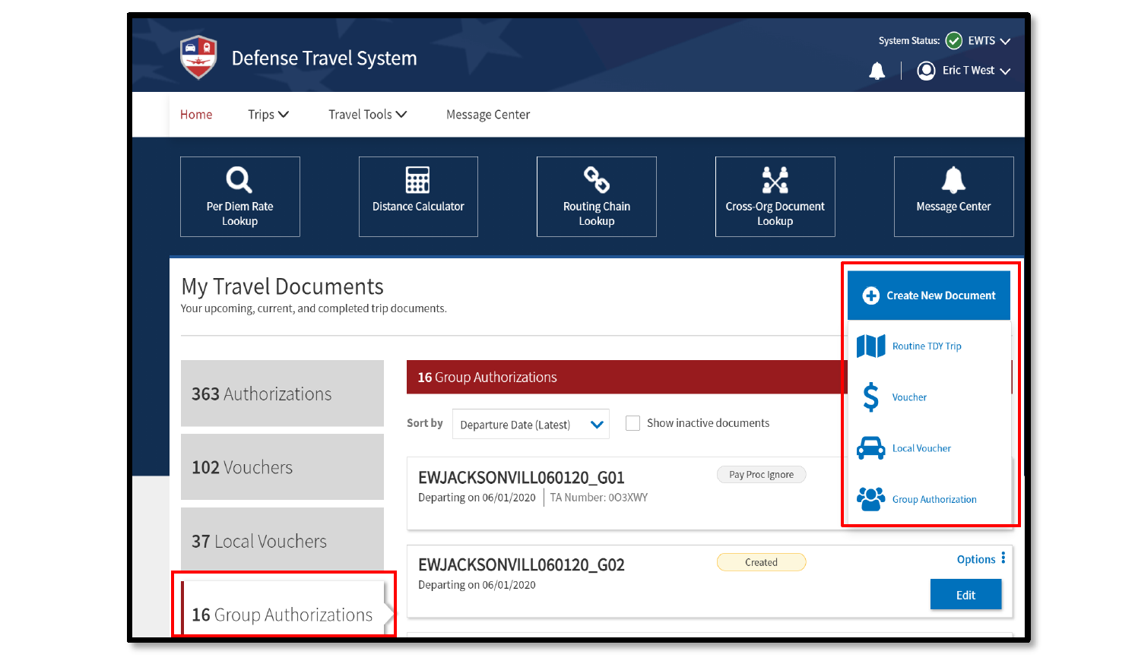

Slide 9
DTS Point of Contact
A/HEALTH FITNESS/LIBRARY
Don Myers 685- 2791
Duane Dunmire 685-3825
Mary Bowser 685-3967
CAPSTONE
Clifford Wheeler 685-4260
COMMAND GROUP
Michelle Germany 682-3962
EISENHOWER SCHOOL
Vacant
NWC
Susan Schindler 685-4342
Dave Pearson 685-4344
INSS/CSWMD
Brett Swaney 685-2335
Brianna Harwart 685-2217
ISMO
Victoria Zyp 685-4240
Blake Traeger 685-4240
Anna Sherman 685-4240
CISA
Vacant
JFSC/JAWS/JCWS
Iszell Burth (757)443-6281
Laila Perkins (757) 443-6103
Susan Gray (757) 443-6193
Sarah Ezell (757) 443-6088
CIC
Vacant
Lead Defense Travel Administrator
LaKisha White (lakisha.white@ndu.edu)

